Slide 1
TYPES OF WEB
Sibasish Padhy(200301120082)
B.tech(CSE)6th Sem
CUTM,BBSR

Slide 2
TABLE OF CONTENTS
01
SURFACE WEB
04
HOW IT WORKS
02
DEEP WEB
05
TOR CIRCUIT
03
DARK WEB

Slide 3
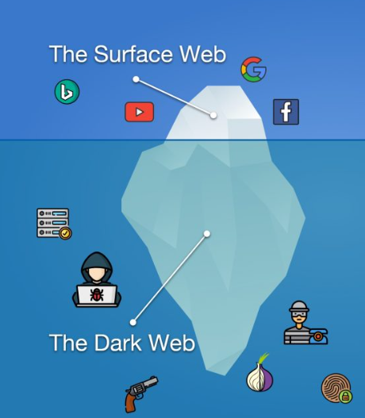
SURFACE WEB
In this web we can browse the websites by their names
Almost all websites are only accessible by confirming the cookies or terms and conditions.
Example. Social media webs.

Slide 4
DEEP WEB
Starts in 1994 as a hidden form of web .
In 2001 it introduced as deep web.
Mainly used by Defense, Hackers, Governments.
Nowadays this is publically available.

Slide 5
DARK WEB
A secret non profit association of well known networks.
It is the deepest part of deep web used to surve the internet by hiding real identity.
Only accessable when the link is shared by a person to another person.

Slide 6
HOW IT WORKS
The ‘Dark Web’ uses complex systems that hides a user’s true IP address, making it very difficult to work out which websites a device has visited.
It is generally accessed using dedicated software, the best known is called Tor (The Onion Router). Around 2.5 million people use Tor every day.
The onion links are accessable via peer to peer network
Which is commonly known as The Onion Router(TOR)
TOR is also downloaded from surface web

Slide 7

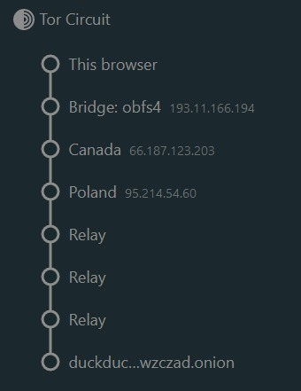
TOR CIRCUIT
In tor circuit it connects the end user and server by the following method.
1st VPN to change the public ip address The browser. 1 bridge ip address. Some countries ip address one by one 2 or 3 relays nodes to receive the traffic from tor network.
Then connected to the site.

Slide 8
Thank you__

